Slide 1
Descriptive Statistics l-2
UNIT 1 (18-12-2020)

Slide 2
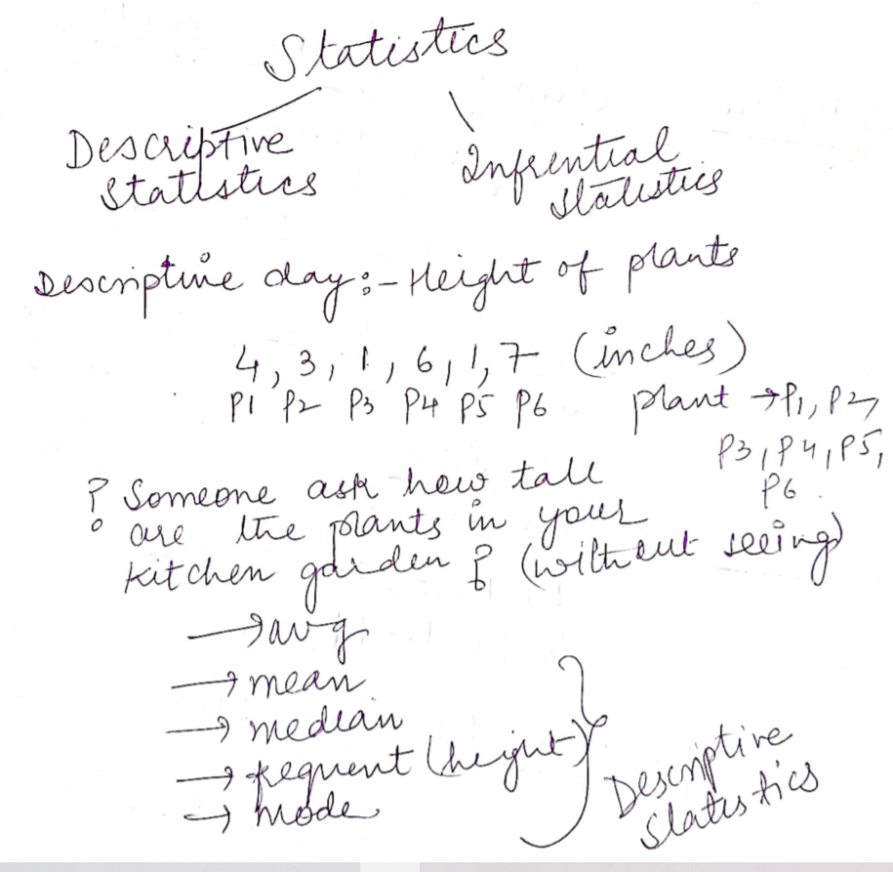
STATIStICS

Slide 3
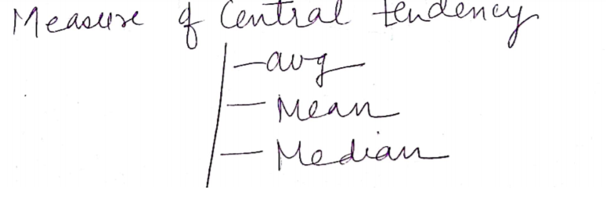
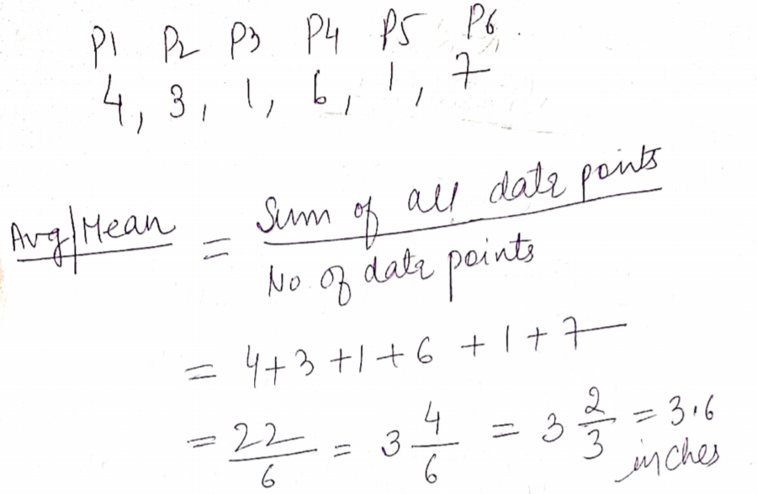

Slide 4
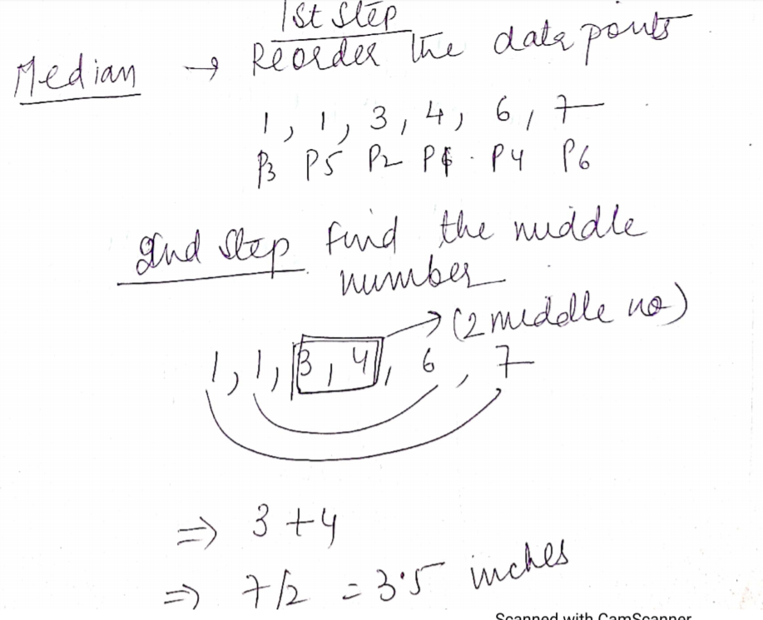

Slide 5
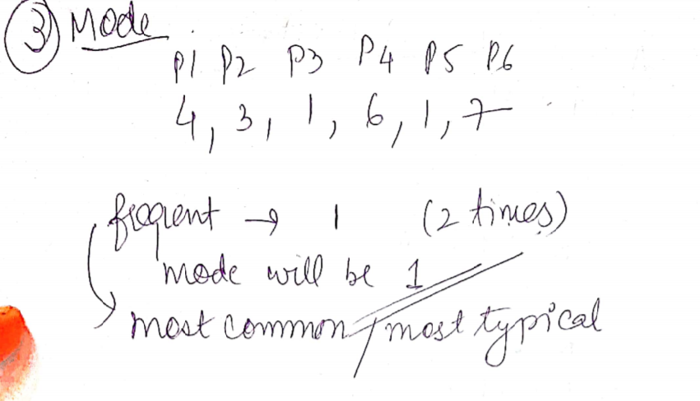

Slide 6
Questions mohit observed the number of minutes his classmates spent on social media sites while they were at the library. He reported his data in the following table.
Class Mate | Number of minutes on social media
Aarush | 13
Monika | 0
Sanyam | 14
Sahil | 36
Priyanka | 18
Mansi | 12
Calculate Mean and Median.

Slide 7
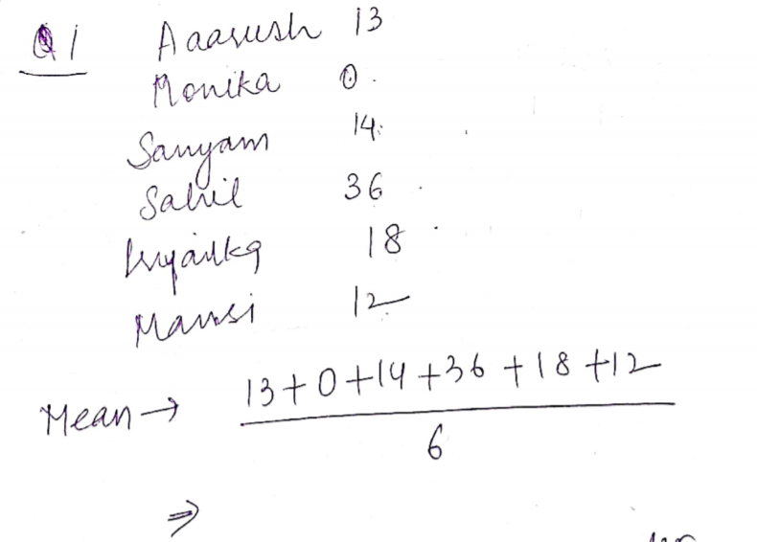
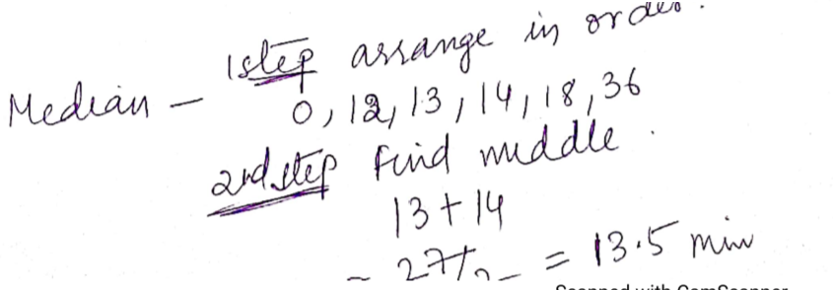

Slide 8
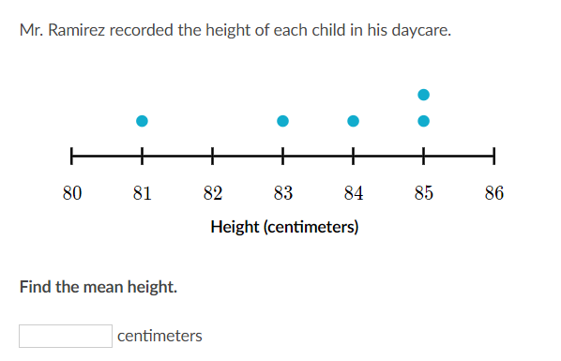

Slide 9
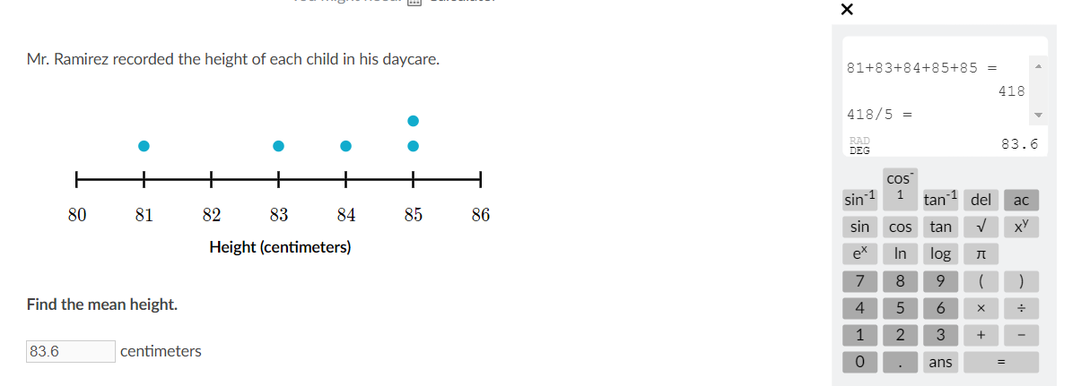

Slide 10
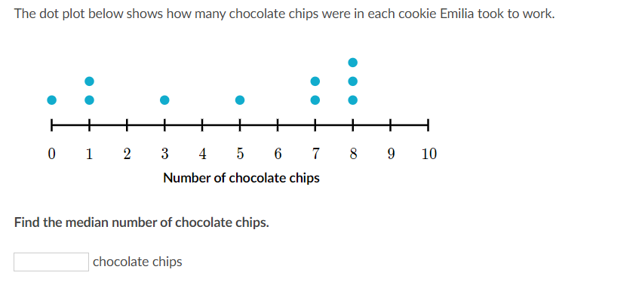

Slide 11
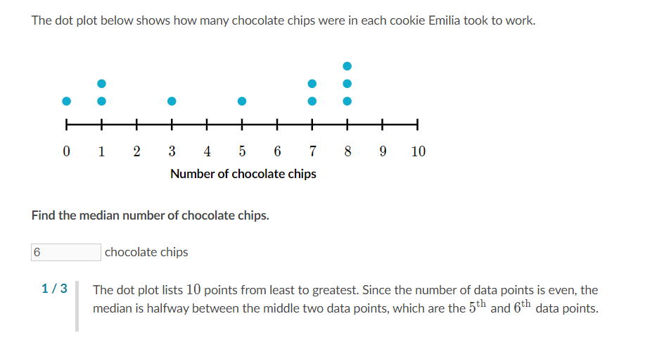

Slide 12
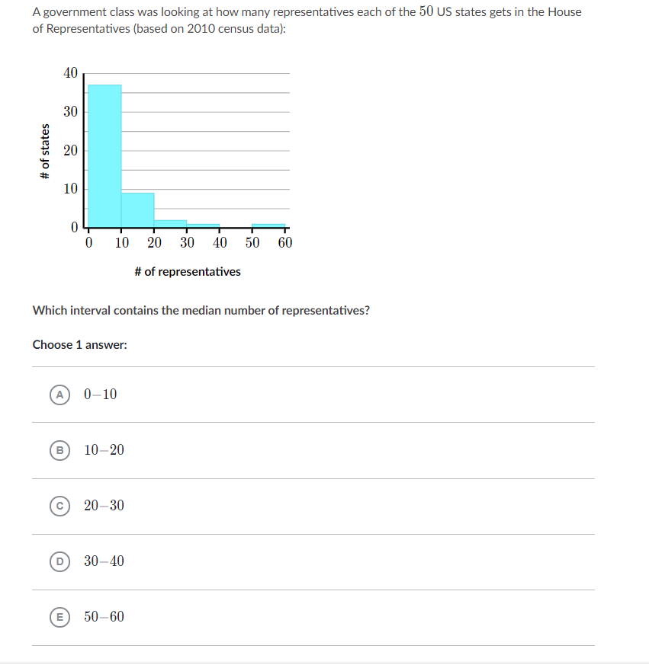

Slide 13
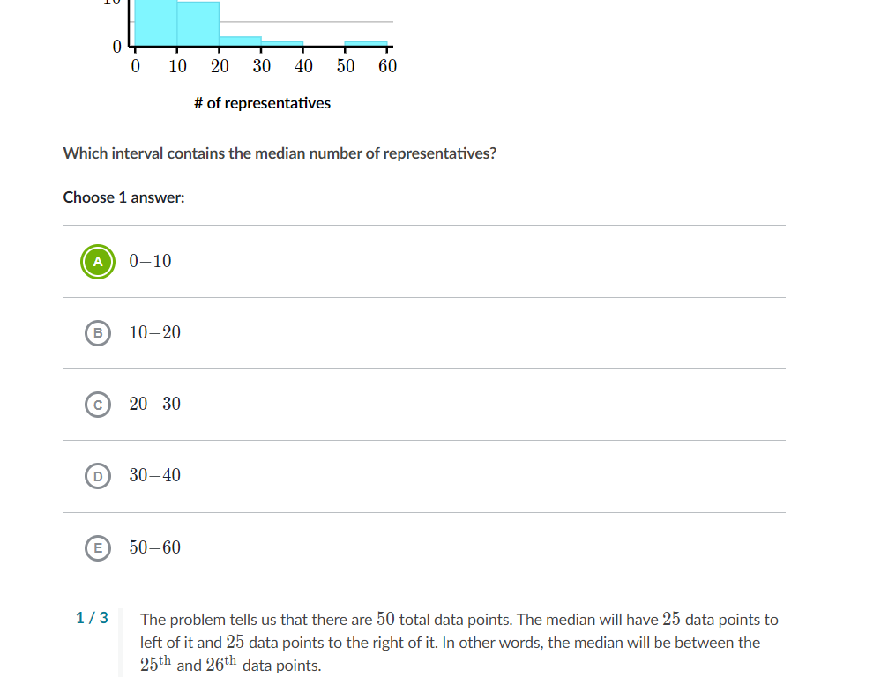

Slide 14
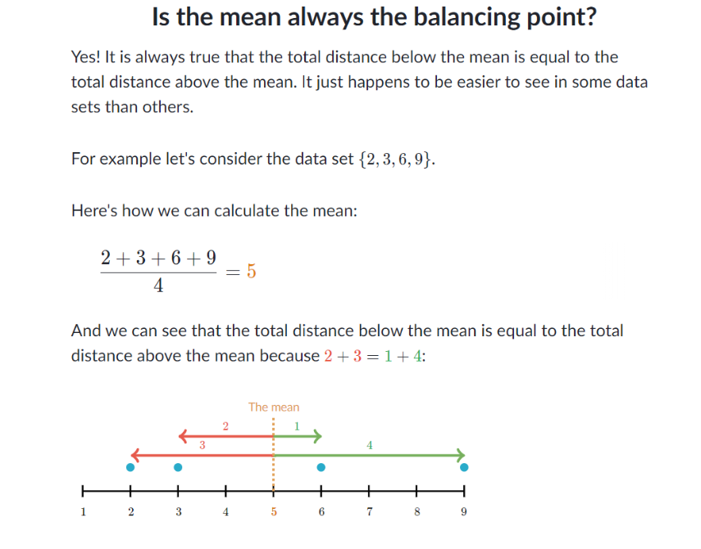

Slide 15
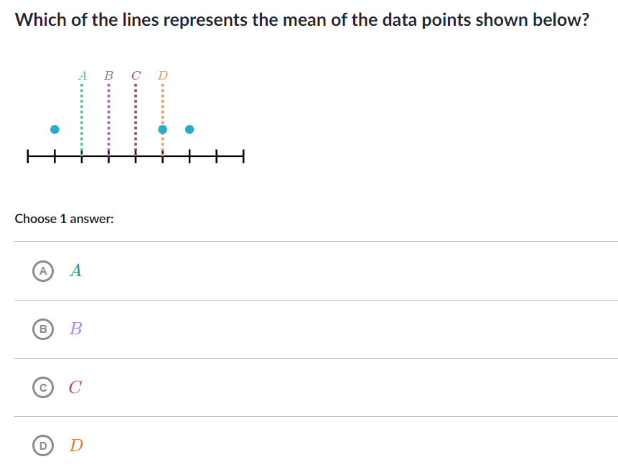

Slide 16
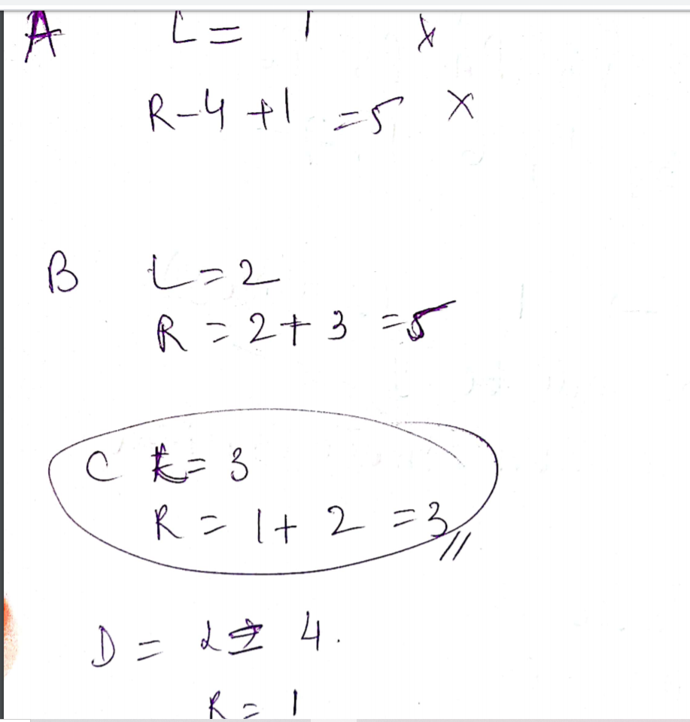

Slide 17
Thanks!!!!!

